Slide 1

MACCHANGER AND WAZUH OPEN SOURCE SIEM
Submitted by
Name : Syed Taif Ahmed Batch ID : 15-JUN-26-CSPP-BUN-750-WDM0930BAN
Name : Sayad Mahapatra Batch ID : 15-JUN-26-CSPP-BUN-750-WDM0930-BAN
Name : Kirankumar Karabasappa Benni Batch ID : 15-JUN-26-CSPP-BUN-750-WDM0930-BAN
Name : Md Mustafa Chand Batch ID : 27-JUL-26-CSPP-BUN-750-WDM0930-BAN
S

Slide 2

PROJECT OVERVIEW
The project shows how it is possible to change the MAC address, check and monitor this process in a closed environment. The Macchanger utility was used in the project to change the MAC address for the experiment. The MAC filtering feature was used to check if the new MAC address is allowed or denied. The tcpdump utility was used to capture packets to see if the connection was established. Wazuh was used to monitor the system and send out an alert in case of a MAC address change. This experiment helps to understand how it is possible to monitor changes to the MAC address and better protect the network.

Slide 3
PROBLEM STATEMENT
MAC (Media Access Control) addresses are unique identifiers of devices in a network, but they can be modified using tools such as Macchanger. In this case, the recognition of devices by their MAC address and, therefore, their control is complicated. It becomes necessary to determine with high probability whether the MAC address of a device has been changed and notify administrators in a timely manner. With the help of Wazuh, it is possible to monitor the state of the system and thereby detect changes in the MAC address. Such a scenario can mislead an administrator, for example, if he cannot distinguish between the real device and the one being tested. It becomes necessary to monitor connections on a regular basis and react immediately to suspicious activity. Timely detection and collection of evidence of tampering with this parameter will ensure high security and integrity of the network.

Slide 4
OBJECTIVES
The main objectives of this project are as stated below:
The original MAC address of this system will be identified and recorded.
The presence and proper working of Macchanger will be determined.
The MAC address will be changed to a different test address.
It will be determined whether the MAC address was changed successfully or not.
Ping traffic will be sent from Kali Linux to the Ubuntu Wazuh server.
Wazuh will be used to identify any MAC address changes.
A test will be done to determine whether a changed MAC address is allowed or not.
The MAC address will be changed back to its original value.
A screenshot will be taken and the procedure documented.

Slide 5
TOOLS AND TECHNOLOGIES
1. VMware
The software is used to create and maintain virtual computers for the project.
2. Kali Linux
The distribution is used for testing purposes. It is utilized to alter the Media Access Control (MAC) address and fork network traffic.
3. Ubuntu
The platform is used as the server computer. The Wazuh tool is integrated into the system for network monitoring functionalities.
4. Macchanger
It is a command-line software that allows changing the MAC address in Kali Linux.

Slide 6
6. Wazuh
The tool is used to monitor the traffic and trigger alerts when the traffic is altered. It helps detect the test due to the change in the Media Access Control (MAC) address.
7. Ping
It is a network utility used to send a request from Kali Linux to Ubuntu to test communication. The traffic is captured by tcpdump for analysis.

Slide 7
LAB ENVIRONMENT
For this practical task, our team of four members implemented a small virtual network, which was set up in the VMware platform in order to ensure the safe testing of the previously described procedure. The diagram below includes two virtual machines: Kali Linux, which is used to perform the testbed activities, and Ubuntu with Wazuh, which is used to monitor the Kali Linux IP and MAC address changes.
The tools that were used for this practical assignment are as follows
VMware – was used to build the virtual network environment.
Kali Linux – was used as a host for implementing the test.
Ubuntu – was used as a monitoring station.
Macchanger – was used to alter the MAC address.
Wazuh – was used to monitor the activities of the Kali Linux virtual machine.

Slide 8
Network Information:
Kali Linux IP: 192.168.44.133
Ubuntu/Wazuh IP: 192.168.44.131
Kali Linux Original MAC: 00:0c:29:46:be:f9
Test MAC: ca:c5:be:23:4a:c7
During the practical task, a procedure, which included the following stages, was fulfilled:
Determine the original MAC address of the Kali Linux virtual machine
Change the MAC address to the previously described one
Monitor the address changing procedure with Wazuh
After the test was complete, the original address of the Kali Linux virtual machine was restored. Thus, the practical task was fulfilled in order to demonstrate the procedure, which can be used to change the virtual machine’s MAC address in the VMware environment.

Slide 9
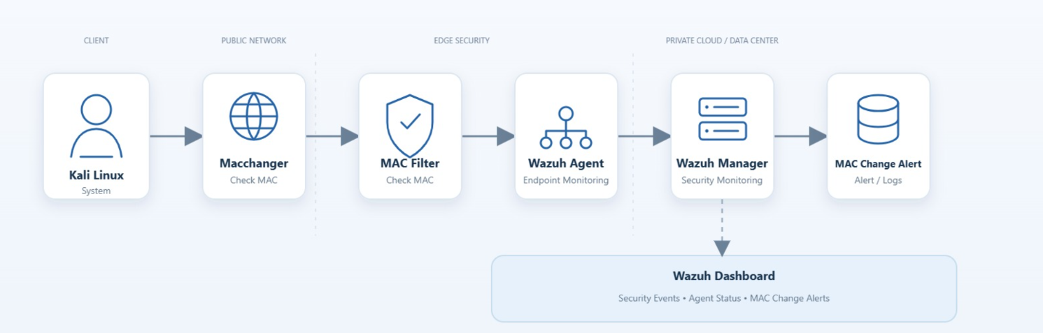
NETWORK ARCHITECTURE
Kali Linux → Maachanger → MAC Filter → Wazuh Agent → Wazuh Manager → MAC Change Alert.

Slide 10
PHASE 1 – MAC & NETWORK SECURITY BASIC
In this stage, we gain a general overview of networking fundamentals. In particular, we learned the principles of MAC addresses, IP addresses, ARP, Ethernet, and network interfaces. It will be helpful for understanding how networks work in general and what network security is about. In addition, the knowledge gained will help us perform practical exercises in the following stages.
The Kali Linux system is connected to the network. The commands below were used to check the MAC address, IP address, and network connection of the system. The IP address of Kali Linux is 192.168.44.133. The ping utility was used to check if Kali Linux can communicate with the other device 192.168.44.131. It can be seen that there are replies from the ping command. This means that the two systems can communicate together.

Slide 11
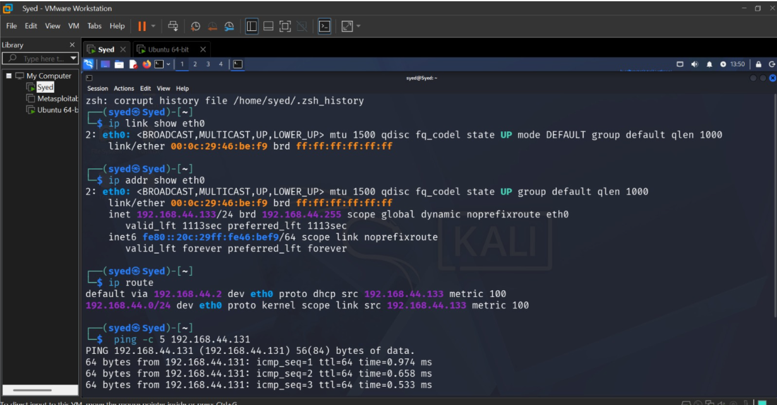

Slide 12
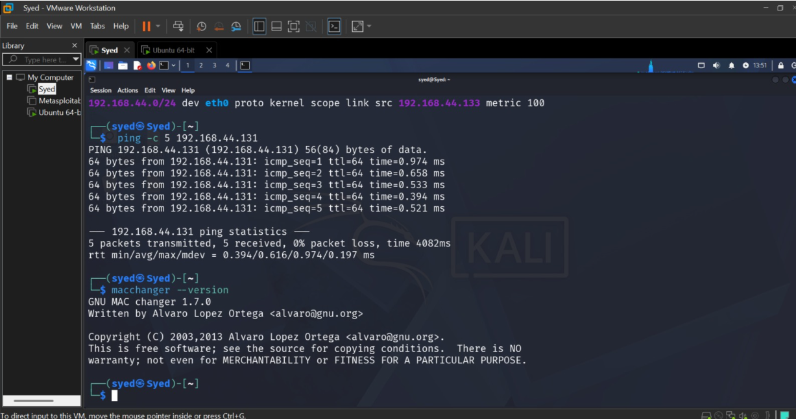
The screen below shows that there is a successful ping to the device 192.168.44.131. This implies that there is a connection through the network with 0% packet loss. In addition, it can be seen that the MACchanger utility version 1.7.0 is ready to be used and will be used to test the MAC addresses.

Slide 13
PHASE 2 : MAC SPOOFING WITH MACCHANGER
The Macchanger utility was used to check the MAC address of the eth0 network interface. The current MAC address and the permanent MAC address were checked and found to be the same in the beginning. Therefore, no changes were made at the moment. Then the mac-filter.conf file was opened to configure it for the next stage of testing. This action allowed creating conditions for testing the MAC filter and MAC address changing in general. The described preparations were made in the controlled laboratory environment for security testing purposes.

Slide 14
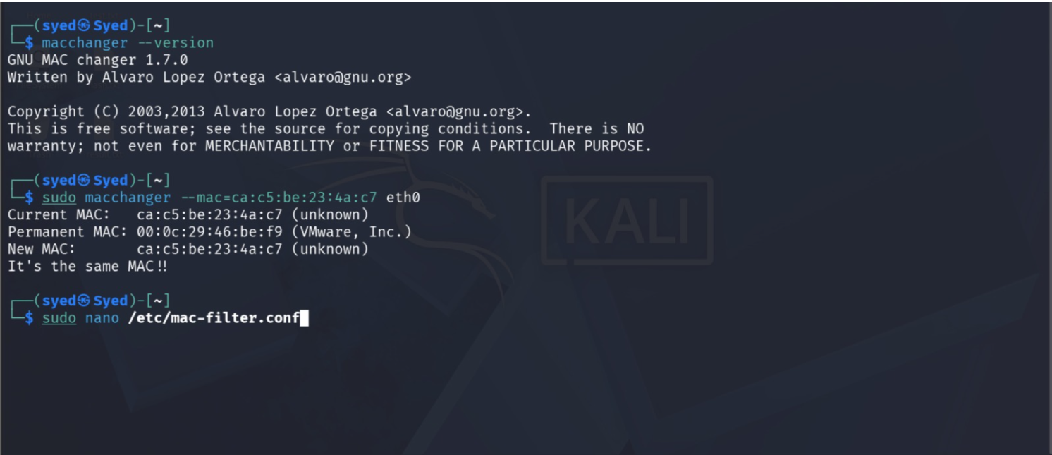

Slide 15
PHASE 3 : CONTROLLED MAC FILTERING SIMULATION
A MAC filtering configuration was set up to permit only one MAC address to access the network. The allowed MAC address was added to the mac-filter.conf file. A shell script was then created to compare the current MAC address with the allowed MAC address in the configuration. If they match, the result is an ALLOWED device; otherwise, it is a BLOCKED device.
The MAC filtering script was tested with two various MAC addresses. Firstly, with a current MAC address, the result was “BLOCKED” since it is not allowed. However, when changed to an allowed MAC, the result became “ALLOWED”. Secondly, a testing scope file was created to clearly describe the project environment, allowed and disallowed activities.

Slide 16
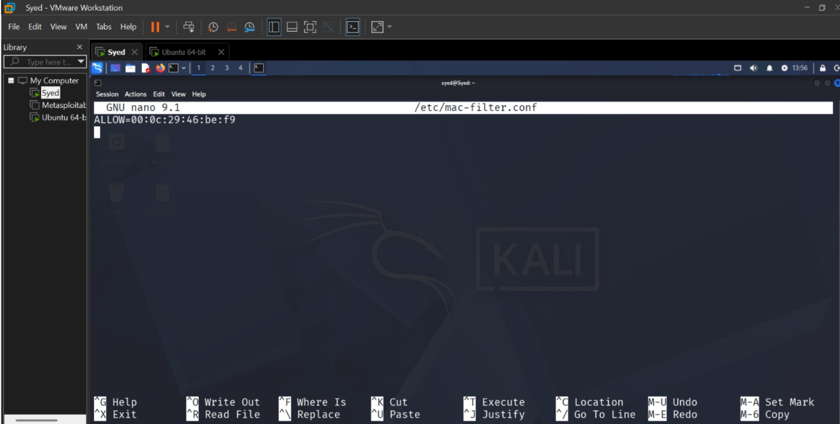

Slide 17
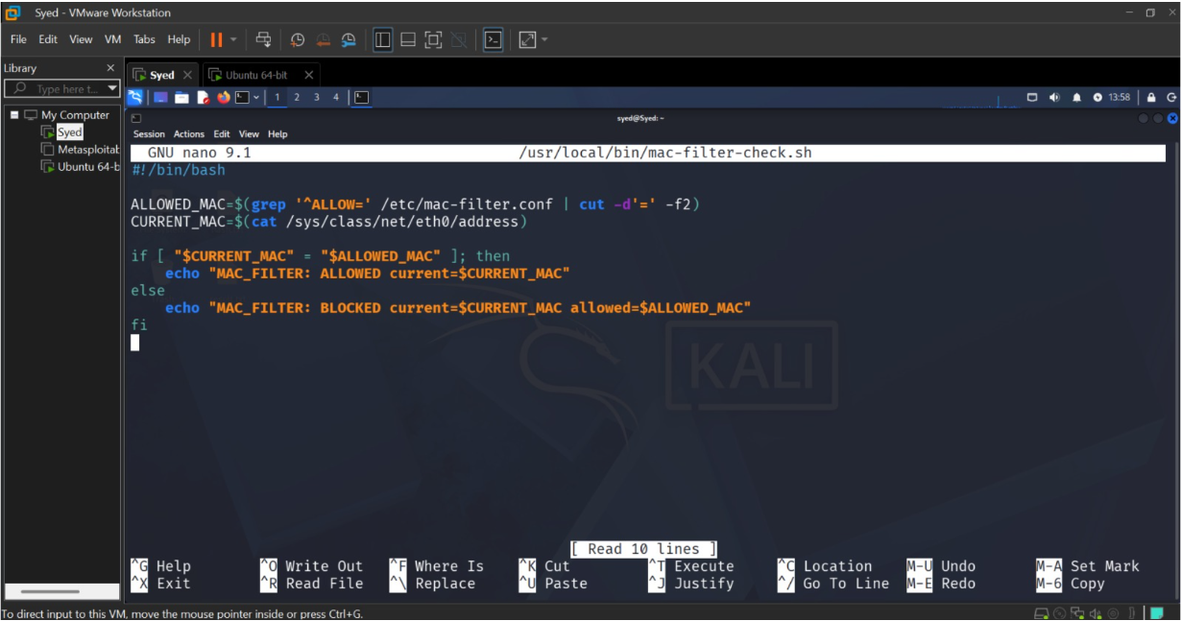

Slide 18
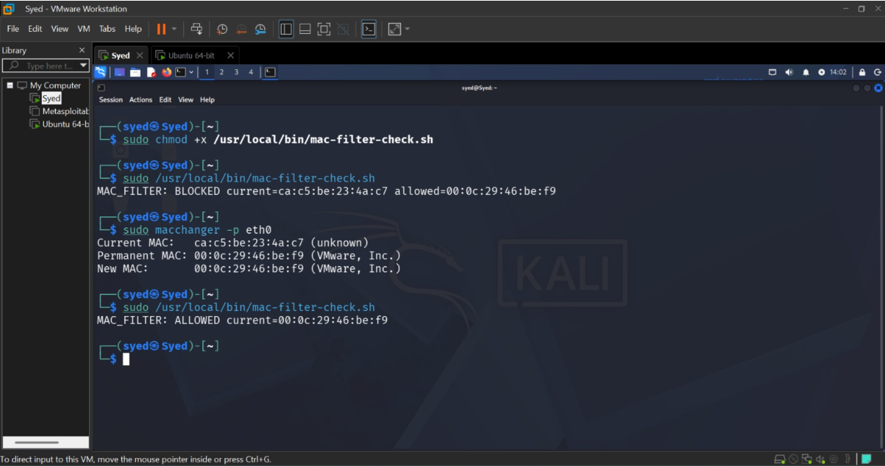

Slide 19
PHASE 04 : MODIFICATION
In this stage, Wazuh was configured to monitor changes in the MAC address. Firstly, a check-mac.sh script was created for checking the MAC address of the system. Then, Wazuh was set up to execute the script and monitor the MAC change log. A Custom Rule with Rule ID 100100 was created to monitor the MAC_CHANGED message. Once a change in the MAC address was detected, Wazuh alerts and raises an alarm. As a result, the monitoring of MAC address changes is ensured in Wazuh to be able to detect possible security issues timely. The usage of such monitoring also allows simplifying the detection process since every change can be viewed in the logs and analyzed by Wazuh.

Slide 20

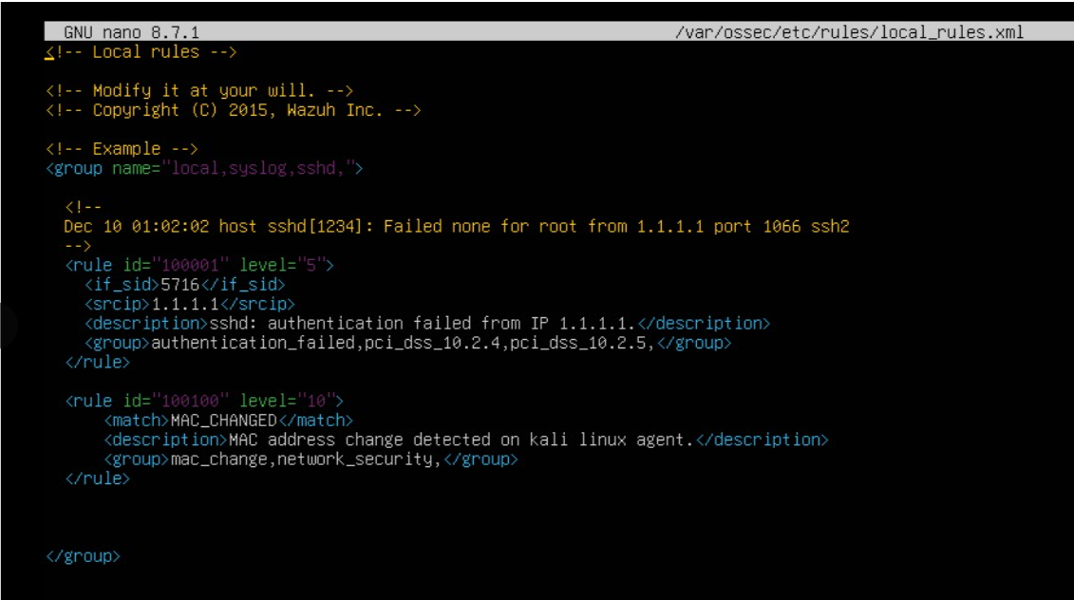

Slide 21
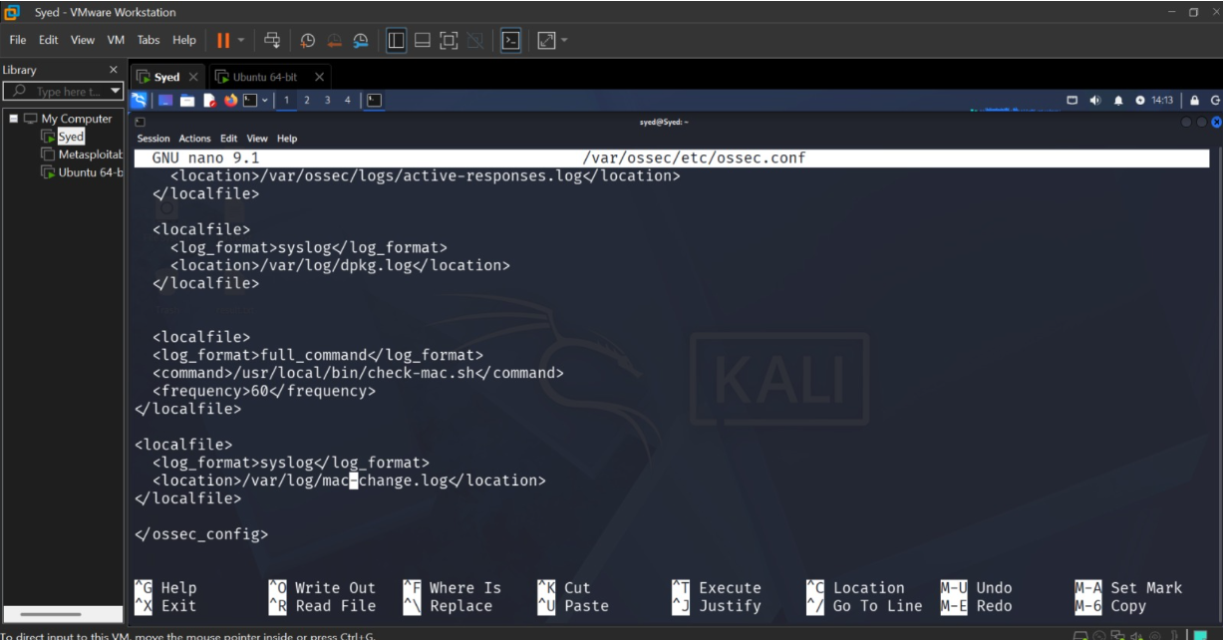

Slide 22
PHASE 05 : SECURITY RECOMMENDATION
Monitor MAC Addresses: Use tools such as Wazuh to frequently check and document any changes in MAC addresses.
Enable Port Security: Set up the network switches to be able to block unauthorized MAC addresses.
Make Use of 802.1X Authentication: The method should guarantee that only authorized devices are allowed access into the network.
Maintain an Updated Device Inventory: Have a firm record of all the devices and their corresponding MAC addresses.
Regular Log Review: Frequently look through the system’s logs for any irregularity such as the unauthorized change of a MAC address.
Conduct User Awareness Training: It is important to routinely educate the users and administrators on the possible risks and proper procedures concerning MAC spoofing attempts.

Slide 23
PHASE 06 : CONTROLLED IDENTITY – SPOOFING SIMULATION
In this phase, it was necessary to change the MAC address for testing purposes in a closed laboratory environment. For this purpose, the original MAC address was changed to another test MAC address with the help of the Macchanger utility. The event of changing the MAC address was tracked by Wazuh, which stored information about the old and new MAC addresses in the event log and raised an alert with Rule ID 100100. Thus, it was possible to test and verify the work of detecting a MAC address change.

Slide 24
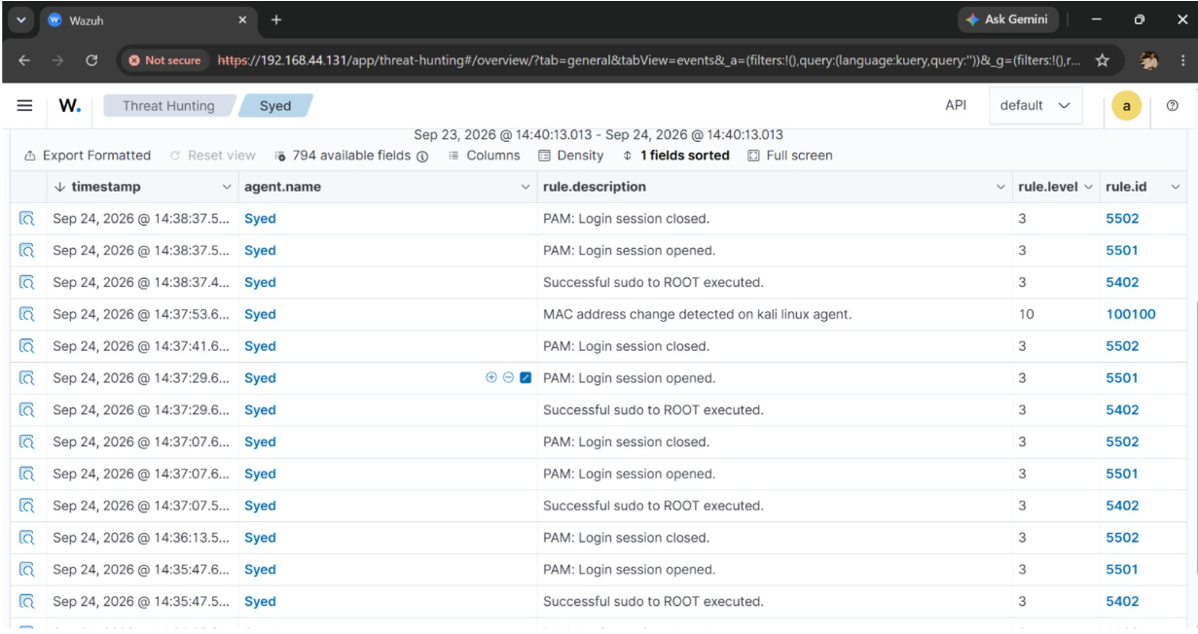

Slide 25
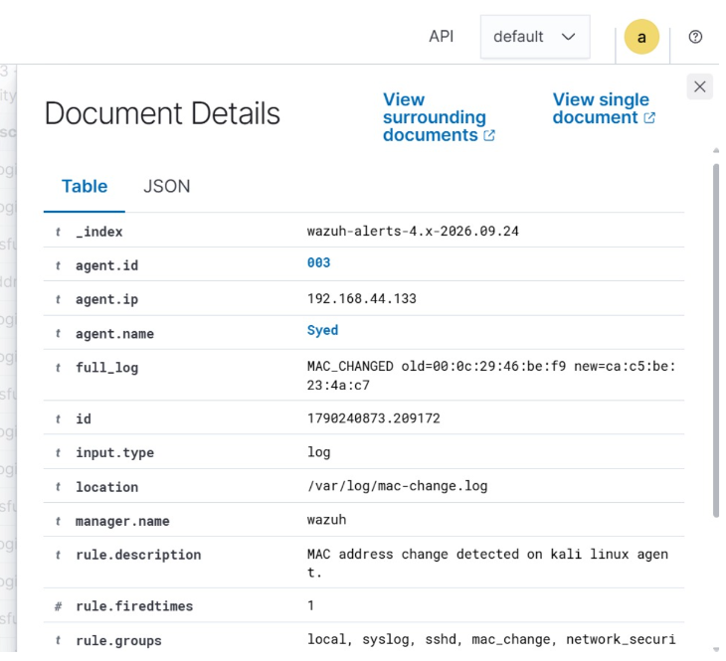

Slide 26
LIMITATIONS
Limited Testing Environment – Only limited testing environment was used for the project which is a controlled VMware lab and not an actual network environment.
Few Devices Tested – Limited testing was done on different devices and MAC addresses.
Focus on MAC Address Changes – Mostly the project revolves around detecting and monitoring the changes in the Media Access Control (MAC) Addresses.
Wazuh Configuration – The detection and monitoring of the MAC Addresses required proper configuration of the Wazuh which might not be possible in all cases.
Not All Aspects of the Attack – The project does not address all aspects and types of attacks or network security problems.
MAC Address Alone is not sufficient – Detection of unauthorized devices using a MAC Address is not enough to have a completely secured network and some other security measures should be added.

Slide 27
FUTURE IMPROVEMENTS
Check the assigned MAC address regularly to ensure that no unauthorized alterations have occurred.
Conduct the test using different devices for the experiment's improvement.
Add more rules to the Wazuh tool in order to identify other security issues.
Set up an email or any other type of notification for an automatic alert system when the change of a MAC address is detected.
Enhance the security system by integrating a combination of user credentials, IP address, and MAC address as identification data.

Slide 28


